Slide 1
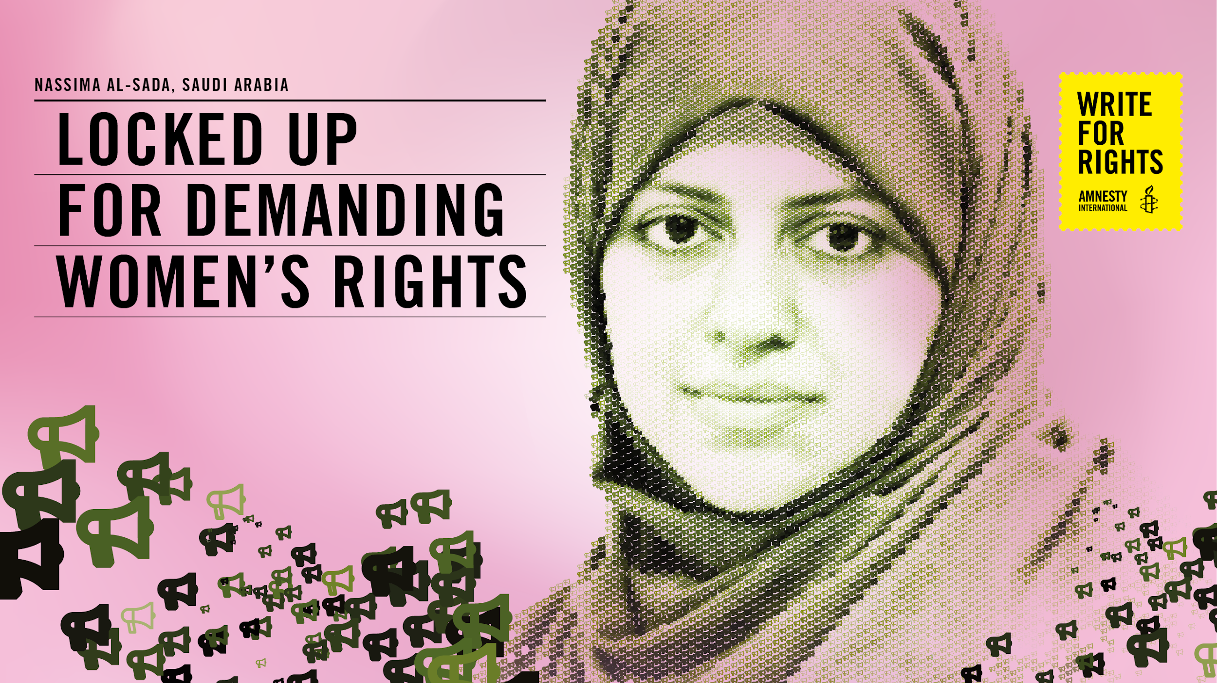
Notes:
The powerpoint presentation needs be used together with the HRE activity of the same name that you can download here https://www.amnesty.org/en/latest/education/2020/10/write-for-rights-human-rights-education-toolkits/

Slide 2

MY DECISION,
MY LIFE
Draw a flower with five or six large petals
on a piece of paper.
Write in each petal something you feel is very important for you to decide on for your life.
For example: What you wear, study, music you listen to, who are your friends
W4R 2020 ACTIVITY: DEMANDING WOMEN’S RIGHTS
2
Notes:
Welcome participants and ask each of them to draw a flower with five or six large petals on a piece of paper. Ask them write in each petal something they feel is very important to them to decide on for themselves. For example, what they wear, what they study, what music they listen to, who they are friends with, what hobbies or sports they want to practise, how they spend their money, how they spend their free time, who they have a relationship with, what they read, among other thing

Slide 3
MY DECISION,
MY LIFE
What is important for you to decide on:
W4R 2020 ACTIVITY: DEMANDING WOMEN’S RIGHTS
3
Notes:
Once everyone has completed their flower, ask participants to show their flowers and read out the things they wrote down and/or share in the chat

Slide 4
MY DECISION,
MY LIFE
How do you feel when you can’t decide on something yourself?
How would you feel if someone else was given responsibility to approve, or not, the decisions you feel are important for you
to decide?
Is there any difference in your community or country between what people of different genders are able to decide? Why, or why not?
W4R 2020 ACTIVITY: DEMANDING WOMEN’S RIGHTS
4
Notes:
Reflect with the participants on the questions. Important: Participants may reflect on how they feel when parents or a guardian make decisions that they feel they should make. It is important that this activity is not about debating whether parents should make decisions for young people but rather exploring how it feels when someone makes decisions about your life that you feel are important for you to make

Slide 5
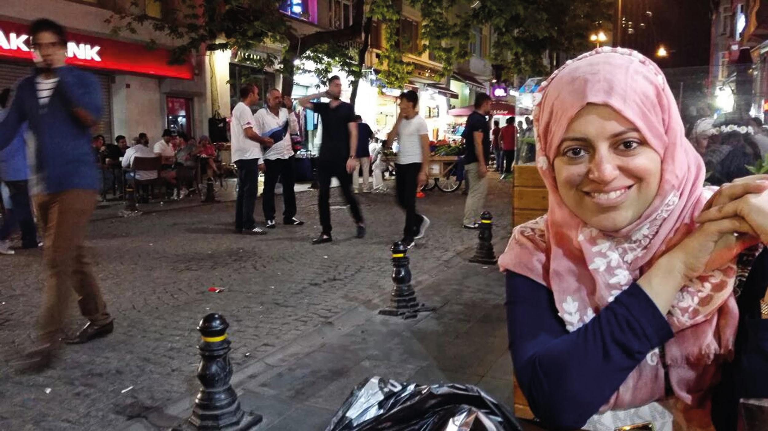
“WHEN A WOMAN FEELS THAT SHE
CAN’T CARRY OUT BASIC TASKS...
THIS RESTRICTS HER HUMANITY”
NASSIMA AL-SADA

Slide 6
MALE GUARDIANSHIP
SYSTEM
The male guardianship system in Saudi Arabia requires all women to legally have a male guardian (who can be father, husband, brother, or son) to make decisions and give permission for different aspects of their lives. In some cases where a woman is widowed, their male guardian may be their son, regardless of age, who has the authority to make decisions on behalf of their mother.
W4R 2020 ACTIVITY: DEMANDING WOMEN’S RIGHTS
6
Notes:
MALE GUARDIANSHIP SYSTEM
Explain that for a woman in Saudi Arabia, no matter what her age is, the answers to the previous questions may look different. The male guardianship system there requires all women to legally have a male guardian (who can be father, husband, brother, or son) to make decisions and give permission for different aspects of their lives. In some cases where a woman is widowed, their male guardian may be their son, regardless of age, who has the authority to make decisions on behalf of their mother.
Share with participants the information on male guardianship in Saudi Arabia on page 9 of the HRE Activity that you downloaded Index: POL 32/2890/2020
https://cdn.knightlab.com/libs/timeline3/latest/embed/index.html?source=1iJrpiNp45E3r-QTCFy0q9JuH9rpaRJBROxrDvmrdeO0&font=Default&lang=en&initial_zoom=2&height=650 (You can share the timeline with your group if you want to and go thorugh it to show crackdown on FoE)

Slide 7
WHICH RIGHTS ARE AT RISK UNDER MALE GUARDIANSHIP
Freedom and equality in dignity and rights
Non-discrimination
Right to life, liberty and security of person
Freedom from slavery
Freedom from torture
All are protected by the law
All are equal before the law
A remedy when rights have been violated
No unjust detention, imprisonment or exile
Right to a fair trial
Innocent until proven guilty
Privacy and the right to home and family life
Freedom to live
Right to travel freely within state borders and to other countries
Right to a nationality
W4R 2020 ACTIVITY: DEMANDING WOMEN’S RIGHTS
7
Notes:
Ask participants think about which rights are at risk under Male Guardianship. Participants can put the number of the corresponding right in the chat.

Slide 8
WHICH RIGHTS ARE AT RISK UNDER MALE GUARDIANSHIP
Right to marry and start a family
Right to own property and possessions
Freedom of belief (including religious belief)
Freedom of expression and the right to spread information
Freedom to join associations and meet with others in a peaceful way
Right to take part in the government of your country
Right to social security
Right to work for a fair wage and join a trade union
Right to rest and leisure
Right to an adequate standard of living
Right to education
Right to share in your community’s cultural life
Right to an international order where all these rights can be fully realized
Responsibility to respect the rights of others
No taking away any of these rights!
W4R 2020 ACTIVITY: DEMANDING WOMEN’S RIGHTS
8
Notes:
Ask participants think about which rights are at risk under Male Guardianship. Participants can put the number of the corresponding right in the chat.
Some of the human rights at risk under a male guardianship system include the rights to freedom of expression and of thought, the right to liberty, freedom of movement

Slide 9
MALE GUARDIANSHIP
SYSTEM
Why do you think male guardianship exists in Saudi Arabia?
What should be done to ensure equal rights for women?
W4R 2020 ACTIVITY: DEMANDING WOMEN’S RIGHTS
9
Notes:
If you have time you can reflect further with the following questions.

Slide 10
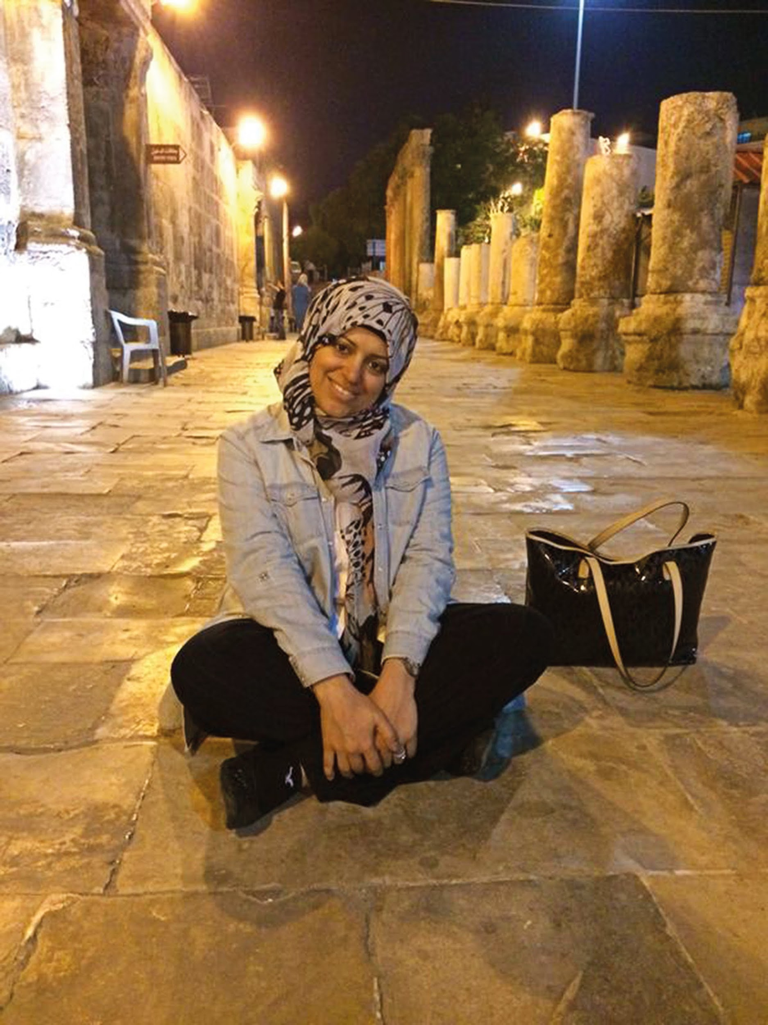
NASSIMA’S STORY
Nassima al-Sada loves animals and cherishes her garden back home. Even in her prison cell, she has a carefully tended plant. It is her only link to the outside world she must sorely miss.
For much of her life, Nassima campaigned for women’s freedom in Saudi Arabia. In doing so, she’s lost her own. She was one of several prominent activists demanding women’s rights to drive and the right to carry out their daily business without the permission of a male guardian.
Saudi Arabia’s guardianship laws required women to seek a man’s permission to go out, and for other basic needs. While these laws have been eased in recent months, the women who have campaigned to end the guardianship system remain behind bars. “Why should an under-age boy be the guardian of a woman who is an adult?” Nassima wrote in 2016. “Why isn’t there an age at which a woman becomes an adult, responsible for her decisions and her life? Why should there be a man responsible for her life?”
Nassima was arrested for her peaceful human rights work in July 2018. While in jail, she was ill-treated. She was placed in a cell alone, in complete isolation from other detainees from February 2019 to February 2020. She is allowed one weekly phone call with her family, but no visits, not even from her lawyer.
She said “When a woman feels that she can’t carry out basic tasks as a citizen without her male guardian, this restricts her humanity.”
Still, Nassima and her family aren’t giving up. Nor should we.
W4R 2020 ACTIVITY: DEMANDING WOMEN’S RIGHTS
10
Notes:
Inform participants that women human rights defenders have been fighting for women’s rights and speaking out against the male guardianship system in Saudi Arabia for years. They will be learning more about one of them.
Read out the Nassima al-Sada story and ask participants How did it feel to hear Nassima’s story?

Slide 11
WHICH HUMAN RIGHTS
ARE VIOLATED
Freedom and equality in dignity and rights
Non-discrimination
Right to life, liberty and security of person
Freedom from slavery
Freedom from torture
All are protected by the law
All are equal before the law
A remedy when rights have been violated
No unjust detention, imprisonment or exile
Right to a fair trial
Innocent until proven guilty
Privacy and the right to home and family life
Freedom to live
Right to travel freely within state borders and to other countries
Right to a nationality
W4R 2020 ACTIVITY: DEMANDING WOMEN’S RIGHTS
11
Notes:
Explain to participants that you will read through the articles in the UDHR summary on the slide. Each time someone feels that Nassima’s human rights have been violated, they should raise their hand and/or put the number of the corresponding right in the chat. As participants are still learning about human rights and only have limited information about Nassima’s story, they may come to different conclusions about the rights involved, but this is ok. Read through the articles, one by one, and give participants time to raise their hand and/or write the number in the chat. Ask a few to explain why they have chosen that right.

Slide 12
WHICH HUMAN RIGHTS
ARE VIOLATED
Right to marry and start a family
Right to own property and possessions
Freedom of belief (including religious belief)
Freedom of expression and the right to spread information
Freedom to join associations and meet with others in a peaceful way
Right to take part in the government of your country
Right to social security
Right to work for a fair wage and join a trade union
Right to rest and leisure
Right to an adequate standard of living
Right to education
Right to share in your community’s cultural life
Right to an international order where all these rights can be fully realized
Responsibility to respect the rights of others
No taking away any of these rights!
W4R 2020 ACTIVITY: DEMANDING WOMEN’S RIGHTS
12
Notes:
Explain to participants that you will read through the articles in the UDHR summary on the slide. Each time someone feels that Nassima’s human rights have been violated, they should raise their hand and/or put the number of the corresponding right in the chat. As participants are still learning about human rights and only have limited information about Nassima’s story, they may come to different conclusions about the rights involved, but this is ok. Read through the articles, one by one, and give participants time to raise their hand and/or write the number in the chat. Ask a few to explain why they have chosen that right.

Slide 13
HUMAN RIGHTS VIOLATIONS IN
THE CASE OF NASSIMA AL-SADA
NAME OF HUMAN RIGHT | RELEVANCE TO NASSIMA’S CASE
Right to a fair trial | Nassima was detained without charge for over a year and has not been able to meet with her lawyer. Diplomats, journalists and independent monitors have been banned from attending her trial sessions.
Right to security | Before Nassima’s arrest, she received some online threats on Twitter.
Right to liberty | Nassima has been detained since July 2018 without charges or trial and has been placed in solitary confinement from February 2019 until beginning 2020.
Right to be presumed innocent until proven guilty | Nassima was threatened verbally and tied to her chair during interrogation.
Right to freedom of expression | Nassima has been detained for trying to educate others and speak up demanding human rights for women.
Right to be presumed innocent until proven guilty | Nassima was detained without charges or trial from July 2018 until June 2019. She has also been placed in solitary confinement from February 2019 until beginning 2020.
Right to be free from discrimination | Nassima is targeted as a woman human rights defender and is discriminated against for demanding an end to discrimination against women.
Right to take part in the government of your country | Nassima stood in municipal elections in 2015 but was banned from participating.
W4R 2020 ACTIVITY: DEMANDING WOMEN’S RIGHTS
13
Notes:
Share and read the relevant rights that are affected in Nassima’s case

Slide 14
PLACE YOUR COUNTRY
ON THE SCALE
What is the situation for girls and women in your country?
1
2
3
4
5
6
7
8
9
10
The rights of girls and women are severely restricted
The rights of girls and women are sometimes limited
Girls and women have equal rights
to men
W4R 2020 ACTIVITY: DEMANDING WOMEN’S RIGHTS
14
Notes:
Ask participants to put a say or put a number in the chat that correspond with the situation of girls and women in their country.
If time permits – Are there decisions that women cannot make but men can? Are women and men treated the same way? Why?

Slide 15
HOW CAN CHANGE
HAPPEN
What needs to be done to change Nassima’s situation and the situation of other women human rights’ defenders?
W4R 2020 ACTIVITY: DEMANDING WOMEN’S RIGHTS
15
Notes:
Ask participants to brainstorm some ideas

Slide 16
MALE GUARDIANSHIP
SYSTEM
Think about the following:
What can be done in order to take action and to support Nassima al-Sada in achieving justice?
How would this change the everyday lives of women in Saudi Arabia?
W4R 2020 ACTIVITY: DEMANDING WOMEN’S RIGHTS
16

Slide 17

HOW DOES WRITE
FOR RIGHTS WORK?
WHY DO WE NEED
TO TAKE ACTION?
In country after country, people’s freedom
to speak out against injustice, to live on their ancestral lands, to not be discriminated against –
is under threat.
Our letters, words and actions will put pressure on authorities to take immediate ​ action, so that those who abuse will be brought to justice. And those unjustly imprisoned will taste freedom ​once again.
People in more than 170 countries and territories take part in all kinds of events
Writing millions of letters, emails, tweets and petitions
Supporting people who’ve been harassed, threatened and unjustly jailed
Putting pressure on governments, leaders and decision-makers
Showing love and support for the people and their families
And making change happen – releasing activists, securing justice for those whose rights have been wronged and protecting people who stand up for change
W4R 2020 ACTIVITY: DEMANDING WOMEN’S RIGHTS
17
Notes:
Explain to participants about the Write to Right Campaign that Amnesty runs each year using the slide. Explain that this year Amnesty is calling on people around the world to take action on behalf of Nassima. If you have time you could share the link of the video in the chat for participants to watch https://www.youtube.com/watch?v=B2zY3J_P3k4&list=PLYFf1wOwAZJBBjjzu6LgpEtR3aeiCqrj6&index=5

Slide 18
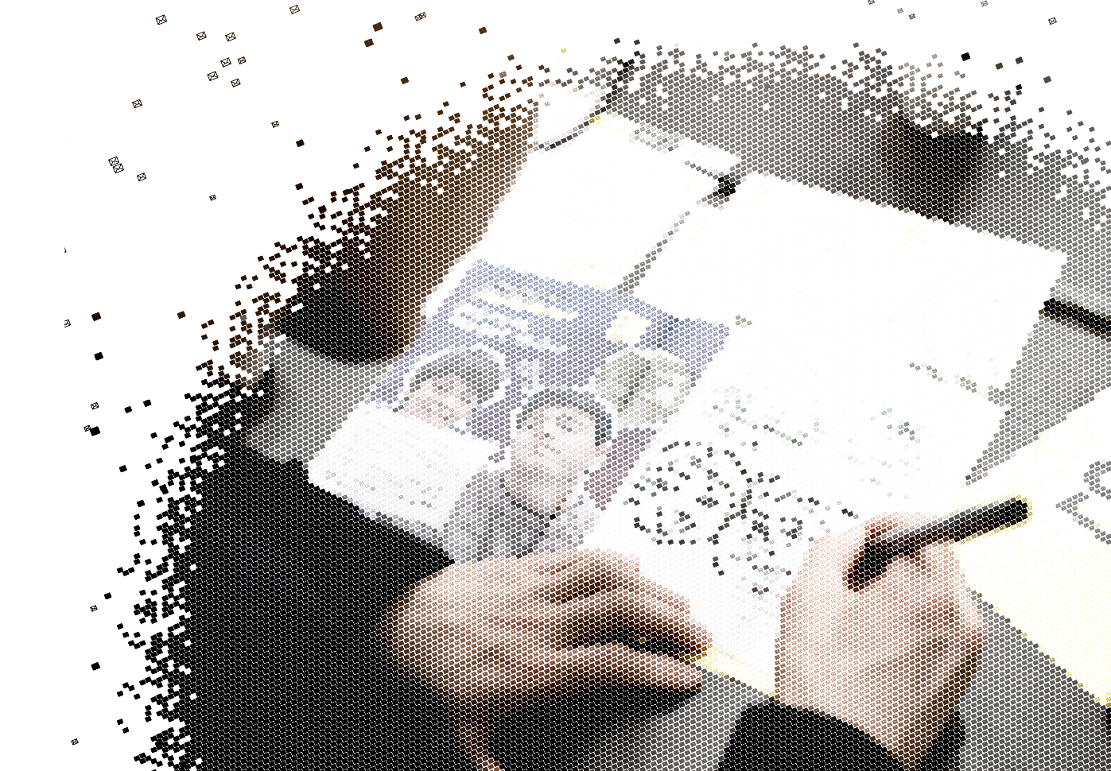
HOW TO WRITE
FOR RIGHTS
1. LISTEN TO THE STORIES
2. WRITE YOUR LETTERS TO:
The government we are trying to persuade to help
the person or people featured in each case
The person or people we want to help, or someone they are close to
3. TAG YOUR LETTERS SO AMNESTY
CAN FIND ​THEM ON SOCIAL
Take a photo of your letter
Post in on your social media channels, tagging it with the unique
event hashtag
Make sure the posts are public so we can find it
4. AMNESTY WILL DELIVER YOUR LETTERS
Amnesty will then collect all actions and give them to the
governments, the people we’re trying to help, or their families
W4R 2020 ACTIVITY: DEMANDING WOMEN’S RIGHTS
18
Notes:
Explain how to write for rights using the slide. Explain that Amnesty is encouraging people to write letters to the authorities and show solidarity for Nassima

Slide 19
WRITE A LETTER,
CHANGE A LIFE
Write to the King of Saudi Arabia at the following address:
His Majesty King Salman bin Abdul Aziz Al Saud
Office of His Majesty the King
Royal Court, Riyadh
Kingdom of Saudi Arabia
Twitter: @KingSalman
Salutation: Your Majesty
You can use the template letters in the letter writing toolkit which you can download on the Write for Rights web page at www.amnesty.org/writeforrights
Use the following guidelines to write a more personal letter:
Tell the King something to make this a personal letter:
Tell him something about yourself
Tell him what shocks you about the case
Tell him to free Nassima and other women’s rights activists immediately and unconditionally
W4R 2020 ACTIVITY: DEMANDING WOMEN’S RIGHTS
19
Notes:
If there isn’t enough time for participants to take action by writing letters.
Participants can also take action online. Share the link https://www.amnesty.org/en/get-involved/write-for-rights/ in the chat.
Tip: You could play some music for the group while they complete this activity

Slide 20
HOW CAN CHANGE
HAPPEN
Write to Nassima expressing your solidarity
or any encouraging words to help keep Nassima’s spirit strong.
Nassima al-Sada loves animals and cherishes her garden back home. Post a photo of you gardening, of some beautiful flowers or nature, or a drawing of animals or plants on your social media channels. You can incorporate the flowers participants created in the activity earlier and take a photo with your flower or put them all together to make a garden. Include a personal message to Nassima.
Remember to tag her @nasema33, as well as
@KingSalman, and use the hashtag #FreeNassima
in each post.
Send hardcopies to Amnesty International
For Moussa
Postbus 1968
1000 BZ Amsterdam
Netherlands
W4R 2020 ACTIVITY: DEMANDING WOMEN’S RIGHTS
20
Notes:
You could play nice music and have people holding the flowers they made in the beginning and you can take a screenshot of the screen and a joint solidarity photo because Nassima loves gardening (links back to beginning.).Share on social media with #W4R20 You can also ask people to go online and sign the petition. You can share the link in the chat https://www.amnesty.org/en/get-involved/write-for-rights/

